Slide 1
Group Three
Pep One Presentation
Finn Mikkola, Jason Fearnall, Alejandro Otaola, Alex Daughters

Slide 2

Overview
Local restaurant - “Ricardo’s“ has requested help organizing their data for further analysis. They have sent all required data sets to our team for an ETL workover.
This will assist the restaurant in understanding their business and help boost revenue moving into the future.

Slide 3
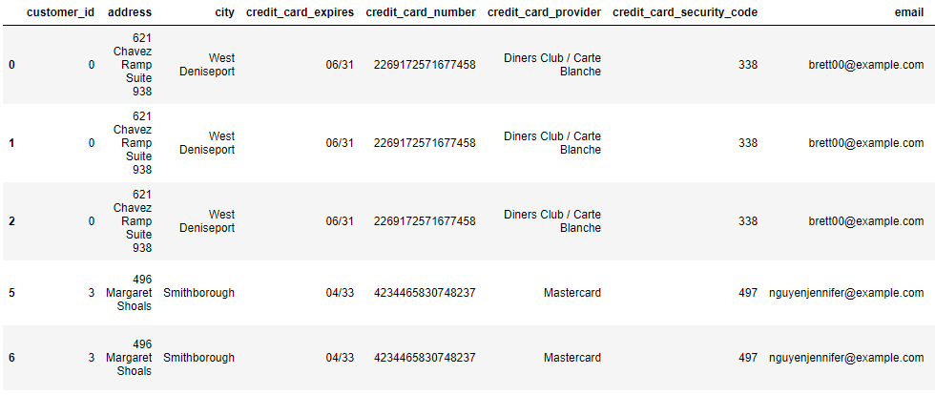
The Data
The Data was provided by two csv’s and one yaml file. It consisted of information about customers with regards to a restaurant such as names, credit card information, address, and past orders. There were 22 columns in all.

Slide 4
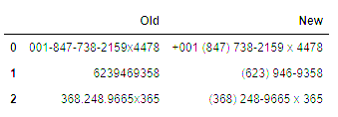
Cleaning Methods
Pandas built in method .drop_duplicated() was an easy and timesaving tool allowing us to remove unnecessary data
We created a customer_id column for customer_demographics and a credit_card_id column.
We created a method to make the phone numbers uniform
Similarly, we built a method to standardize credit card numbers
Emails were checked for valid formatting
Functional code to identify outliers (sorting, checking tolerances against max and min values)

Slide 5
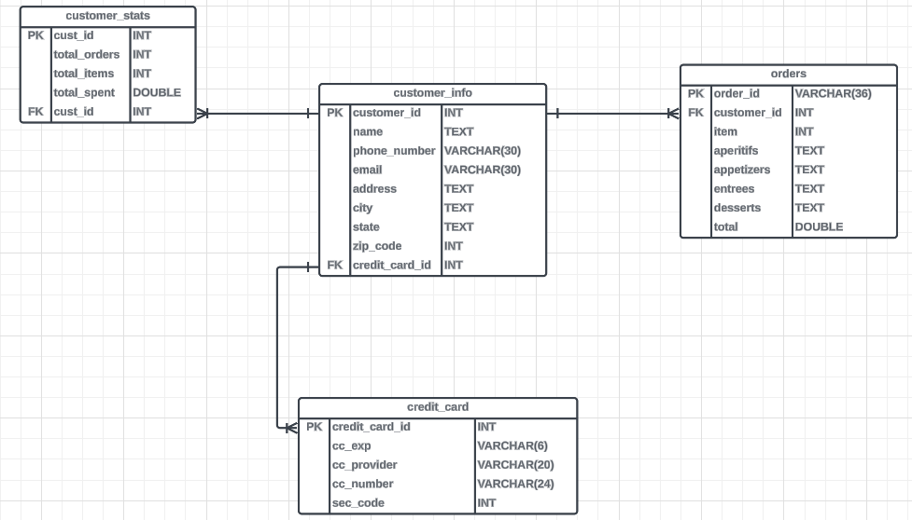
ER DIAGRAM

Slide 6
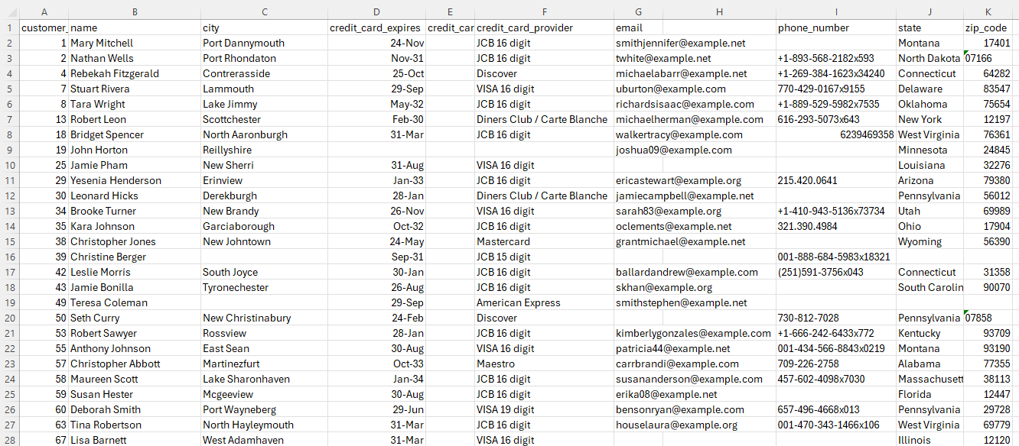
Client .csv File to identify NULL CC records

Slide 7
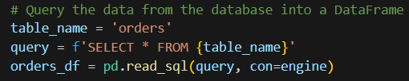
SQL
Imported sqlalchemy to use the create_engine() function to connect to our database
Used the dataframe’s .to_sql method to make our dataframe into sql to put into a database file
Then used SQL queries with .read_sql to be able to read the information back from the database file and put the tables back into dataframes
Ended up with four tables named: orders, credit_cards, customer_info, and customer_stats

Slide 8
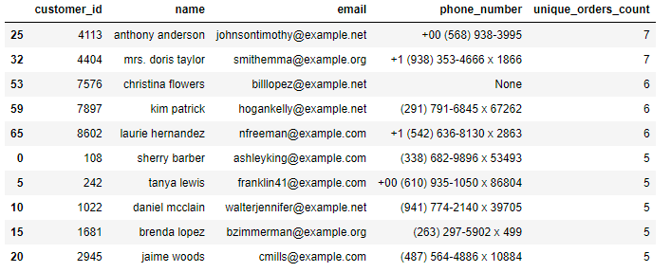
Useful data
Menu item analysis
Most ordered & least popular menu items
Most and least ordered items per product category (entrees, aperitifs,appetizers desserts)
Location
States that most customers live in, giving more insight information on your customer base.
Customers that have placed the most orders
Suggestions:
Revenue analysis
Check the average revenue made per day, week, quarter and per annum
Peak business days and hours

Slide 9
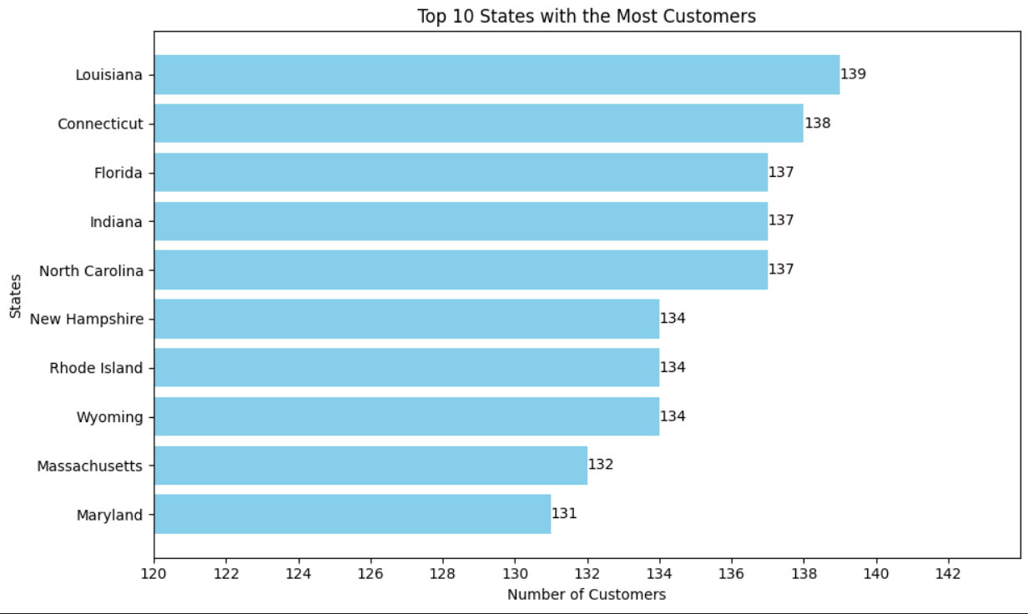
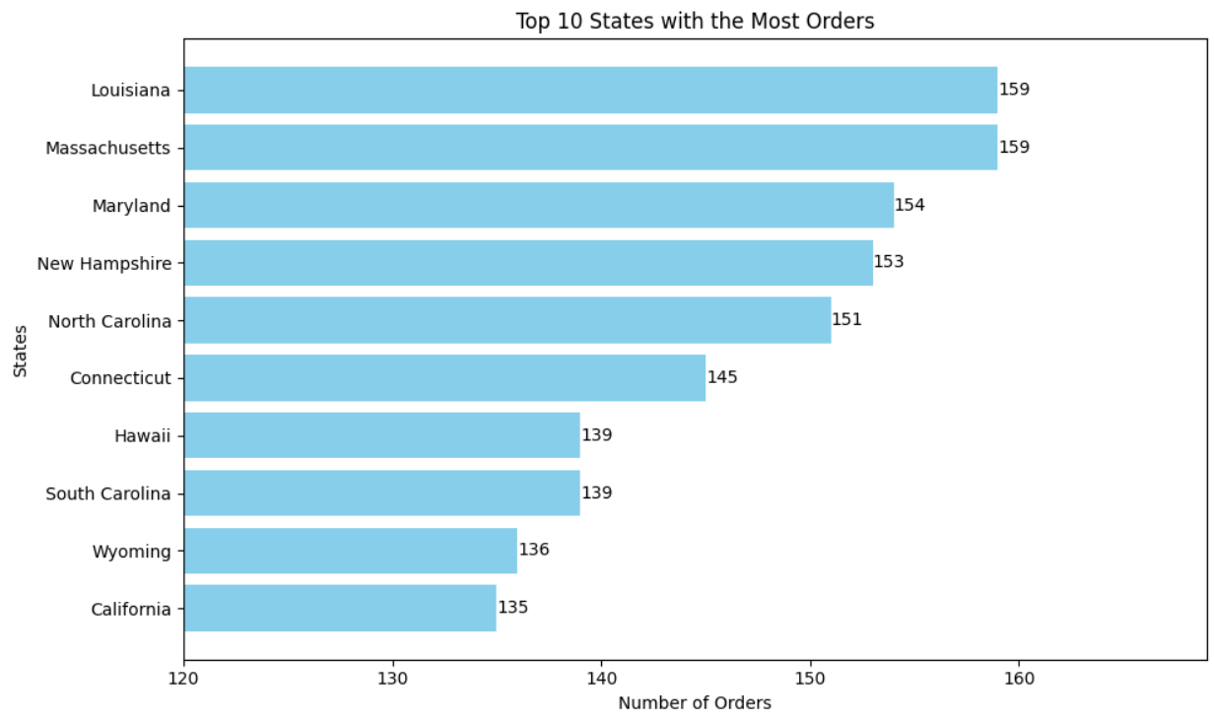
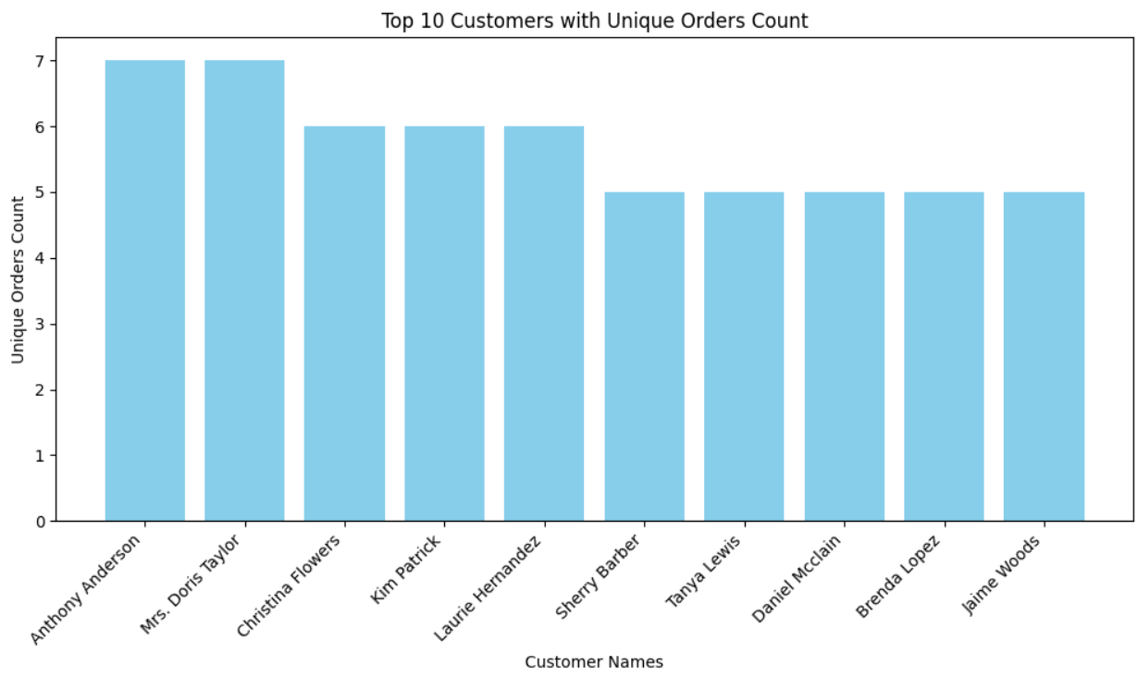

Slide 10
Findings
Large amounts of NULL data which was collected into separate .csv files for client review
Multiple duplicated data instances.
Data inconsistencies such as phone numbers put in with symbols and some without
Unnecessary data columns
Immediate need to normalize raw data files
Source files were inconsistent and required cleaning

Slide 11
Challenges
Data merging /Naming conventions (snake_casing_is_king)
MYSQL vs SQLAlchemy
Understanding dataset with little interaction from client
Dealing with NULL values
Platform issues - Collab vs. Github

Slide 12
Lessons Learned
Communication is KEY!
Explore and tinker with your data (it won’t actually break)
Find time to explore the code and data as a team
Planning ahead can eliminate issues later
Establishing guidelines for naming conventions
Choosing correct platform for team collaboration
Messaging and taking immediate action when problems arise
Teamwork makes the Dreamwork!
Building strong and open working relationships
Helping each other solve problems
Ask questions

Slide 13
QUESTIONS?
COMMENTS?

